Slide 1
Reanalyzing Habitability Claims for K2-18 b Through Forward Models and Retrieval Analysis
Izzy Kahn, Professor Luis Welbanks, Matthew Nixon, Sagnick Mukherjee, Bella Reese

Slide 2
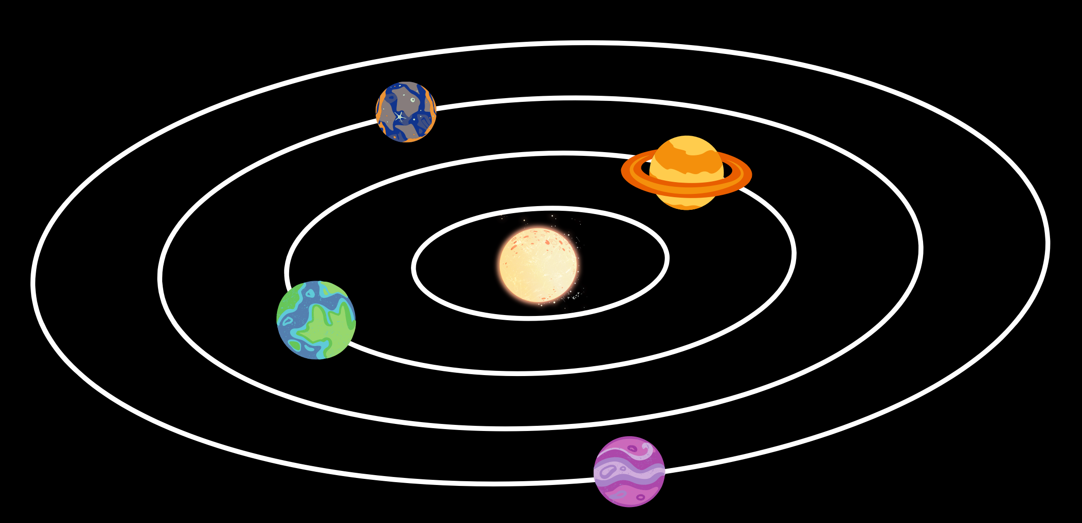
What is an Exoplanet?
Exoplanet = planet outside our solar system
Habitable Zone = the region where liquid water can exist

Slide 3
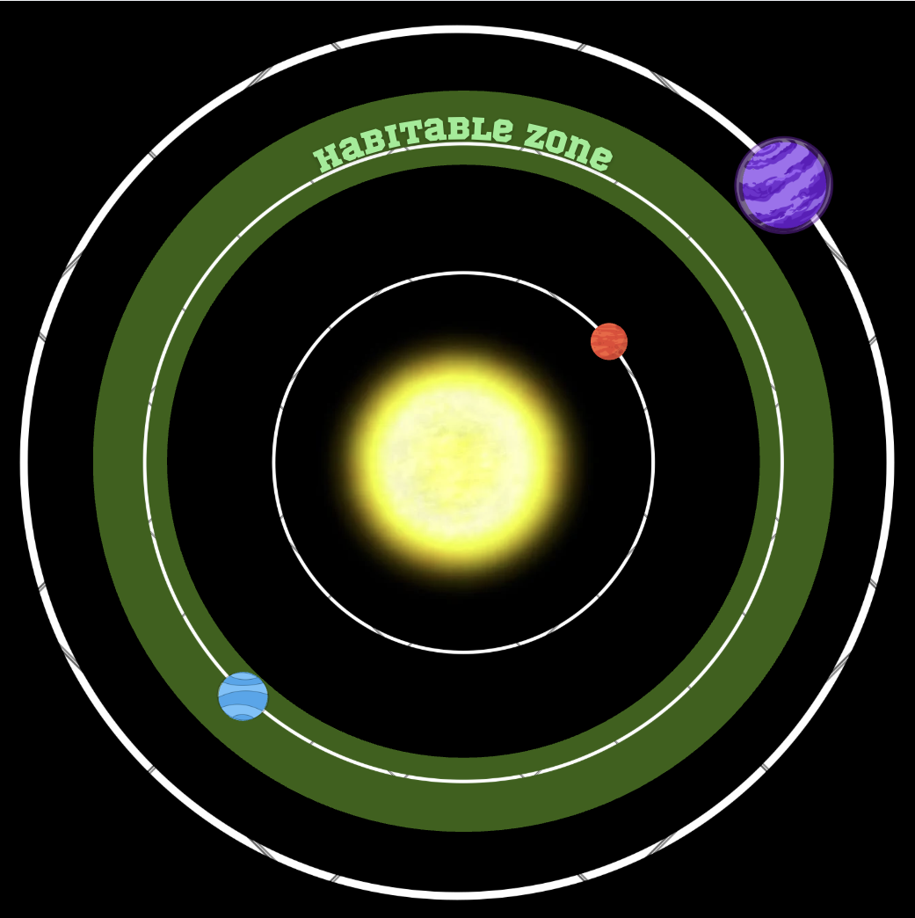

Why K2-18b?
K2-18b is located in the habitable zone of its star (Foreman-Mackey et al 2015)
Claims of atmospheric molecules that could support liquid water ocean and potential life (Madhusudhan et al 2023 & 2025)
In the case of exoplanet K2-18b:
Sub-Neptune planet
Between Earth & Neptune in size
Hydrogen-rich atmosphere (Benneke et al 2019)
Notes:
We are interested in an exoplanet K218b, it was theorized that a certain combination of species ofmolecules in the atmosphere could produce the conditions for a liquid water ocean and potentiallylife
This planet is in the habitable zone of its star, essentially meaning that liquid water could bepossible

Slide 4
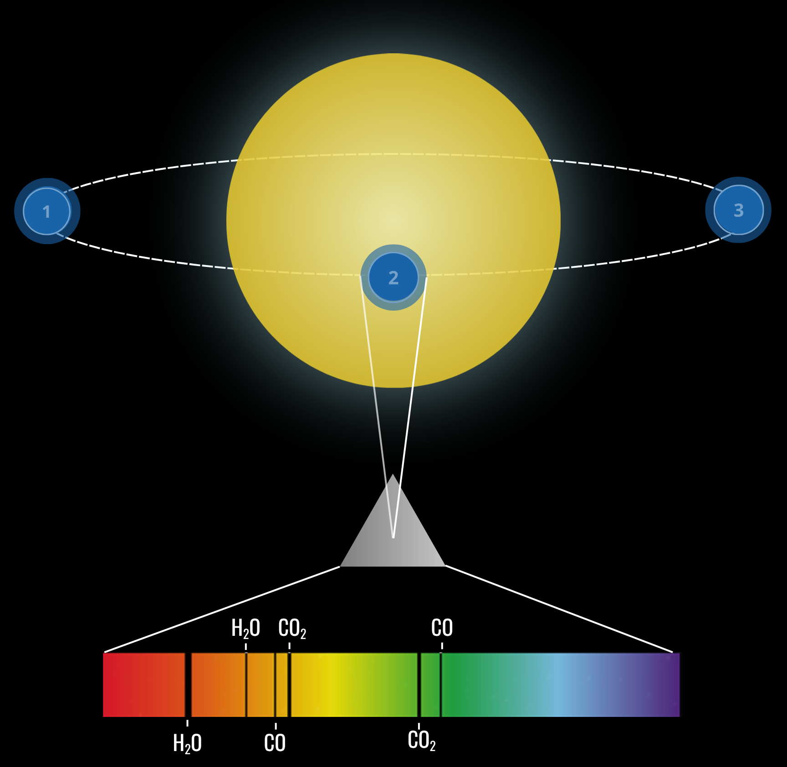
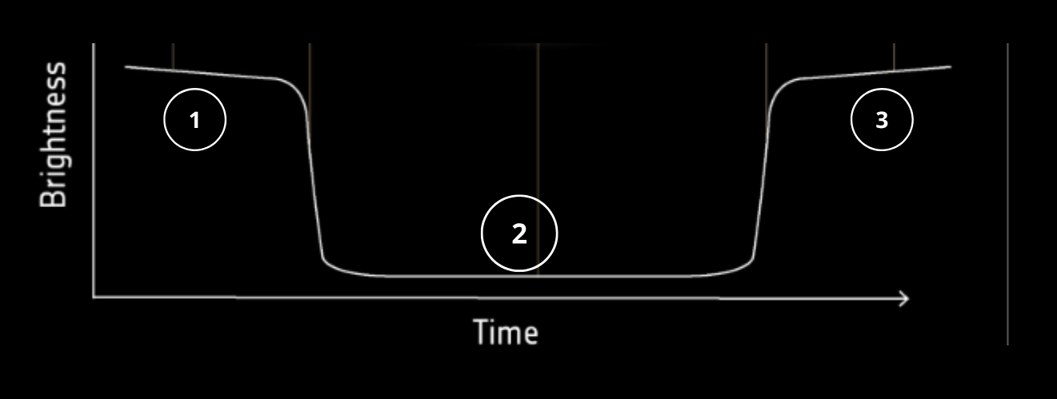
Observing the Atmosphere During Transit
Transit: light passes through atmosphere
Out of Transit
Out of Transit
Transit depth = blocked starlight
Molecules absorb specific wavelengths → spectral fingerprints

Slide 5
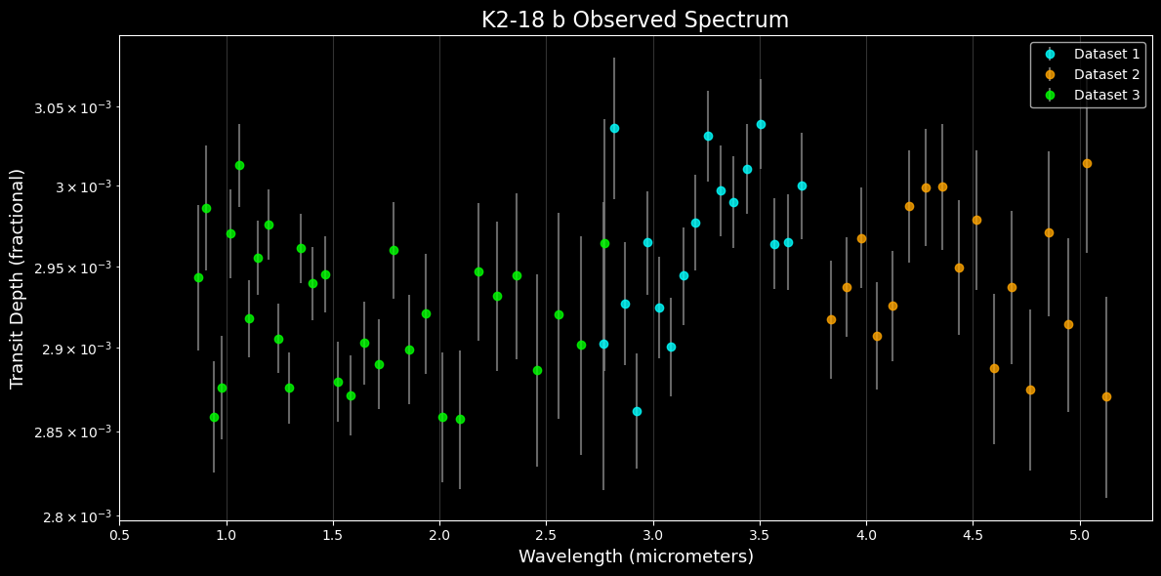
Peaks in the spectrum = light absorbed by molecules
Absorption → more star light blocked, so planet appears larger → bigger transit depth
Each feature corresponds to a specific chemical signature

Slide 6
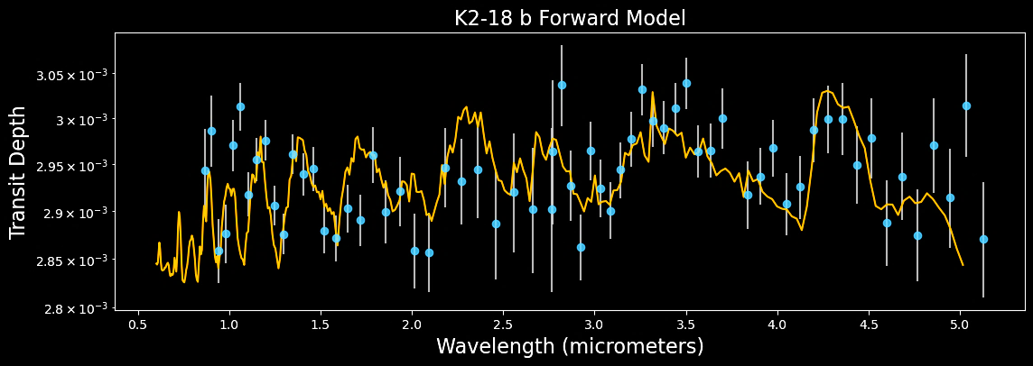
Forward Modeling the Atmosphere
[
Abundances based on (Madhusudhan et al. 2023); CH₄, CO₂, H₂O, NH₃, CO varied, others fixed at 10⁻¹⁰
Goal:
Match atmospheric models to the observed spectrum
Method:
Vary molecular abundances (H₂O, CH₄, CO₂, CO, NH₃)
Adjust temperature and reference pressure
Result:
Identify combinations that best reproduce spectral features
Notes:
Goal: determine what atmosphere reproduces the observed spectrum
Created models with different:
Molecular species
Temperature
Reference pressure
Adjusted parameters to find a best fit
Can a specific combination of species in the atmosphere create a unique model that matches the observed data?
To answer the question of what molecules make up the atmosphere of this sub-neptune exoplanet (why is it considered sub-neptune), Iplotted different combinations of species and adjusted parameters over the observed data to try to get a best fit that matches theobserved data
When manually changing certain parameters, H20, temperature, reference pressure, and other species, I was able to see how the fitwould change when too much of one species was added or not enough.
Using currently known values (I will cite which ones I used), I created a forward model with a generally decent fit. The next step is tolook at how the abundance of ammonia specifically affects the fit of the data
Abundances from: Chachan et al. 2021, ApJL, 917, L12
Changed H2O,CH4,CO2,CO,NH3 and left other species at the same

Slide 7
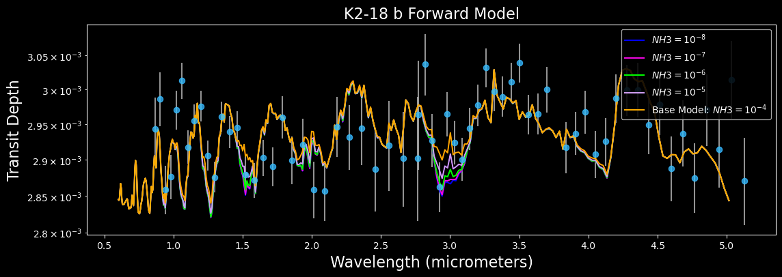
Claims of a Liquid Water Ocean:
Ammonia (NH₃) may indicate presence or absence of a liquid water ocean (Hu et al. 2025)
Forward model runs with varying NH₃ abundances
[
Notes:
We look at ammonia specifically because it can be used as an indicator of a liquid water ocean. NH₃may indicate a liquid water ocean: nitrogen dissolves in water, so low NH₃ favors an ocean, while highNH₃ favors a deep atmosphere with no ocean (Hu et al. 2025).
As seen from the forward model, at different abundance levels of ammonia, it can be seen that . Does itcreate a fit unique to the graph? The data allow a wide range of NH₃ abundances, with no singlepreferred value; as a result, it looks like NH₃ is not well constrained and cannot be used to determinewhether the planet has an ocean.

Slide 8
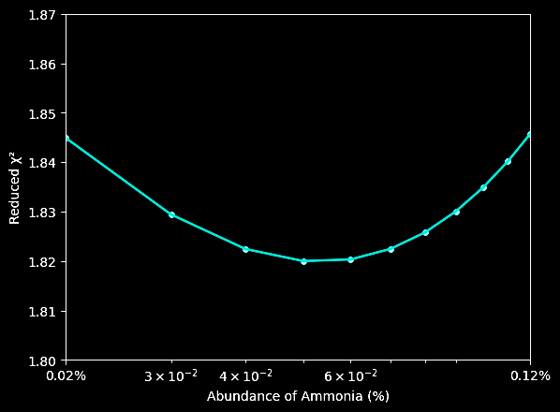
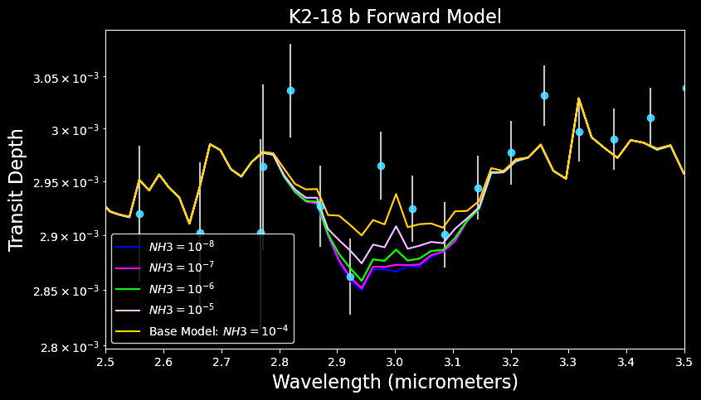
Many abundances fit the data similarly
NH₃ does not produce a unique spectral signature
Conclusion: NH₃ is not well constrained
[
χ² measures goodness of fit between model and data​
Multiple low χ² values → multiple valid interpretations​
Confirms atmospheric degeneracy​
Notes:
We look at ammonia specifically because it can be used as an indicator of a liquid water ocean. NH₃may indicate a liquid water ocean: nitrogen dissolves in water, so low NH₃ favors an ocean, while highNH₃ favors a deep atmosphere with no ocean (Hu et al. 2025).
As seen from the forward model, at different abundance levels of ammonia, it can be seen that . Does itcreate a fit unique to the graph? The data allow a wide range of NH₃ abundances, with no singlepreferred value; as a result, it looks like NH₃ is not well constrained and cannot be used to determinewhether the planet has an ocean.

Slide 9
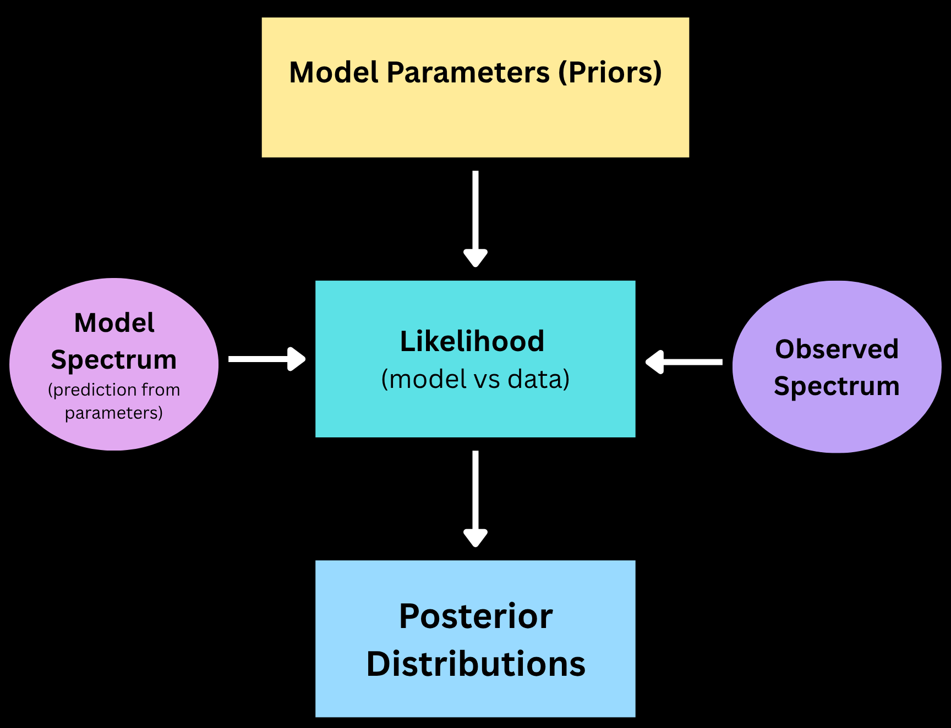
Atmospheric Retrieval (Inverse Modeling)
What does Retrieval do?
Infers atmospheric properties of an exoplanet from an observed spectrum
Method:
Define model parameters (priors)
Generate model spectra
Compare to observed spectrum (likelihood)
Output:
Posterior distributions
Molecular abundances and temperature structure
Uncertainties and degeneracies
[
Notes:
“Retrieval infers atmospheric properties from an observed spectrum. We start with priors on the model parameters, generate model spectra, and compare them to the data through the likelihood. From that, we obtain posterior distributions that tell us the most likely atmospheric properties and their uncertainties.”
Tests thousands of models
Returns probability distributions for:
Molecular abundances
Temperature
Reveals uncertainties and parameter correlations
Overall question for retrieval: What atmosphere would produce the spectrum I observed? Running a retrieval is essentially giving us an inverse model, so we work the other wayaround to try and find a model that is unique. What combination of species best produces the observed spectrum? It is finding which model spectra match your data best, and theninferring the atmosphere from that. Instead of starting with assumed conditions, retrieval asks: what combination of atmospheric properties best produces the observed spectrum? Thismethod tests a wide range of models and returns probability distributions for parameters like molecular abundances and temperature.
The retrieval results show not only the most likely atmospheric compositions butalso the uncertainties and correlations between different parameters. This allows us toassess whichmolecules are well constrained and which remain uncertain.
Exoplanetary atmospheric retrieval refers to the inference of atmospheric propertiesof an exoplanet given an observed spectrum. The atmospheric properties include thechemicalcompositions, temperature profiles, and clouds/hazes. These properties, inturn, can provide key insights into the combination of species within an atmosphere
The retrieval tests a large number of combinations, with the result showingprobability distributions of different species and temperature, assessing the likelihoodof molecules in theatmosphere, while also highlighting the correlation or lack ofcorrelation between them

Slide 10
Posterior distributions from retrieval
Retrieval Results: What do we learn?
Well-constrained (narrow posterior)
Narrow distributions → well-constrained (detections)
Broad / flat distributions → weakly constrained or unconstrained
CH₄ and CO₂ are favored; others remain weakly constrained
Others (e.g., H₂O) → poorly constrained
Degeneracies → different parameter combinations produce similar spectra
[
Weakly constrained
(likely low abundance)
Notes:
Molecules like methane and carbon dioxide have relatively narrow, peaked distributions, which suggests they are more strongly supported by the observed spectrum.
In contrast, many other species show broad distributions or are pushed toward very low abundances, indicating that the data do not require their presence—so they are effectively non-detections.
Additionally, correlations between parameters reveal degeneracies, meaning different combinations of molecules can produce similar spectral features, limiting how uniquely we can determine the atmospheric composition.”
When a molecule’s abundance is pushed to very low values, it indicates that the model does not require that species to fit the data, so it is effectively a non-detection.

Slide 11
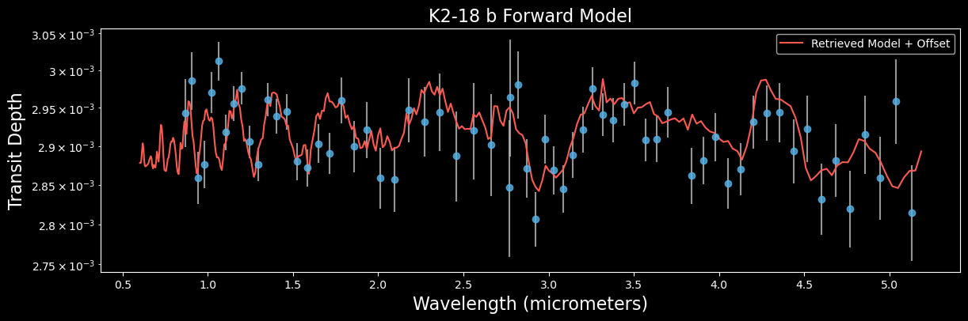
[
Notes:
Both forward modeling and retrieval are able to reproduce the observed spectrum, and both favor methane and carbon dioxide. However, many other species remain weakly constrained, and degeneracies mean that multiple atmospheric compositions can explain the data. Additionally, the need for an offset in the retrieval suggests there are systematic uncertainties. Overall, the data do not uniquely constrain the atmospheric composition.

Slide 12
Conclusion: Do we obtain a unique atmospheric model?
[
Both forward modeling and retrieval reproduce the observed spectrum ​
CH₄ and CO₂ are consistently favored by the data ​
Other species remain weakly or poorly constrained ​
Degeneracies → multiple atmospheric compositions fit the data ​
The data do not uniquely constrain the atmospheric composition
​

